Slide 1
Lecture 13
Graph Convolutional Neural Networks
Presenters: Zhiyao Yan, Sainan Liu, Gautam Nain
Feb 18, 2018

Slide 2
Outline
Motivation
Background:
Graph Definition
Spatial vs Spectral Domains
Challenges
Paper:
DCNN
GATs
SyncSpecCNN
Summary
Takeaway & References
Zhiyao Yan, Sainan Liu, Gautam Nain Lecture -
13

Slide 3
Outline
Motivation
Background:
Graph Definition
Spatial vs Spectral Domains
Challenges
Paper:
DCNN
GATs
SyncSpecCNN
Summary
Takeaway & References
Zhiyao Yan, Sainan Liu, Gautam Nain Lecture -
13

Slide 4
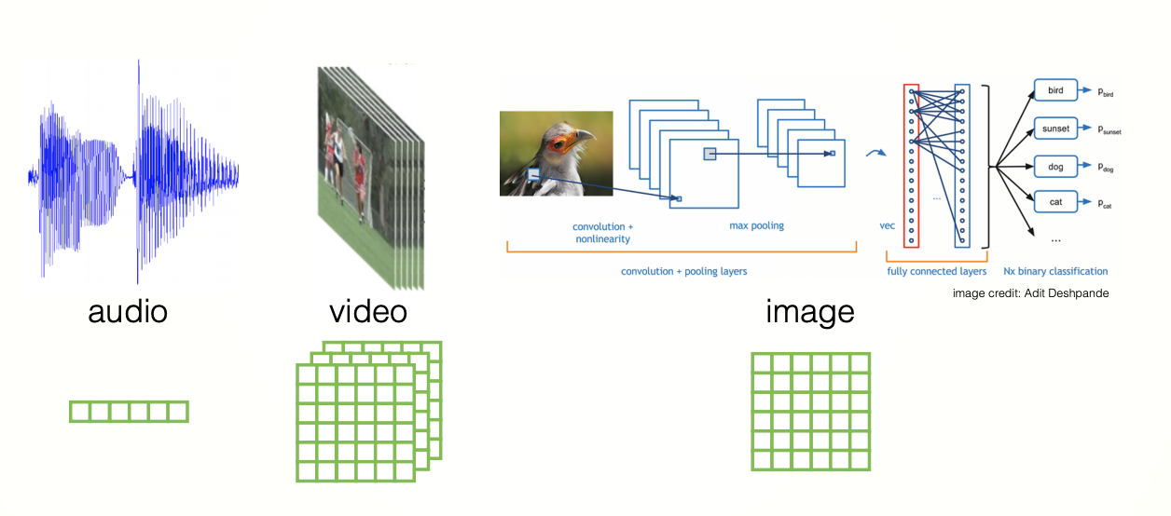
Motivation
CNN has been very successful for a wide variety of applications
Slide borrowed from Li Yi
Zhiyao Yan, Sainan Liu, Gautam Nain Lecture -
13
Notes:
Image convolution is a special case of graph convolution
Ask if everybody is comfortable, raise hands if want a recap of CNN.

Slide 5
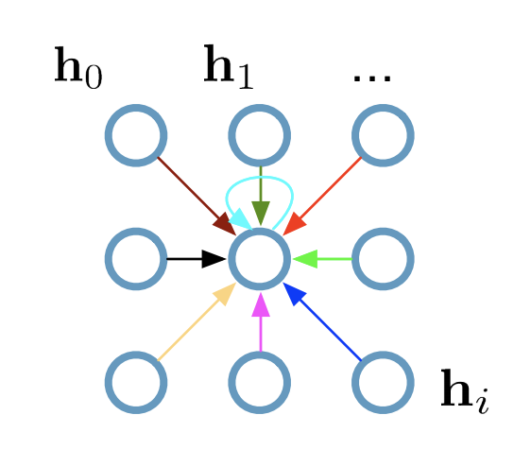
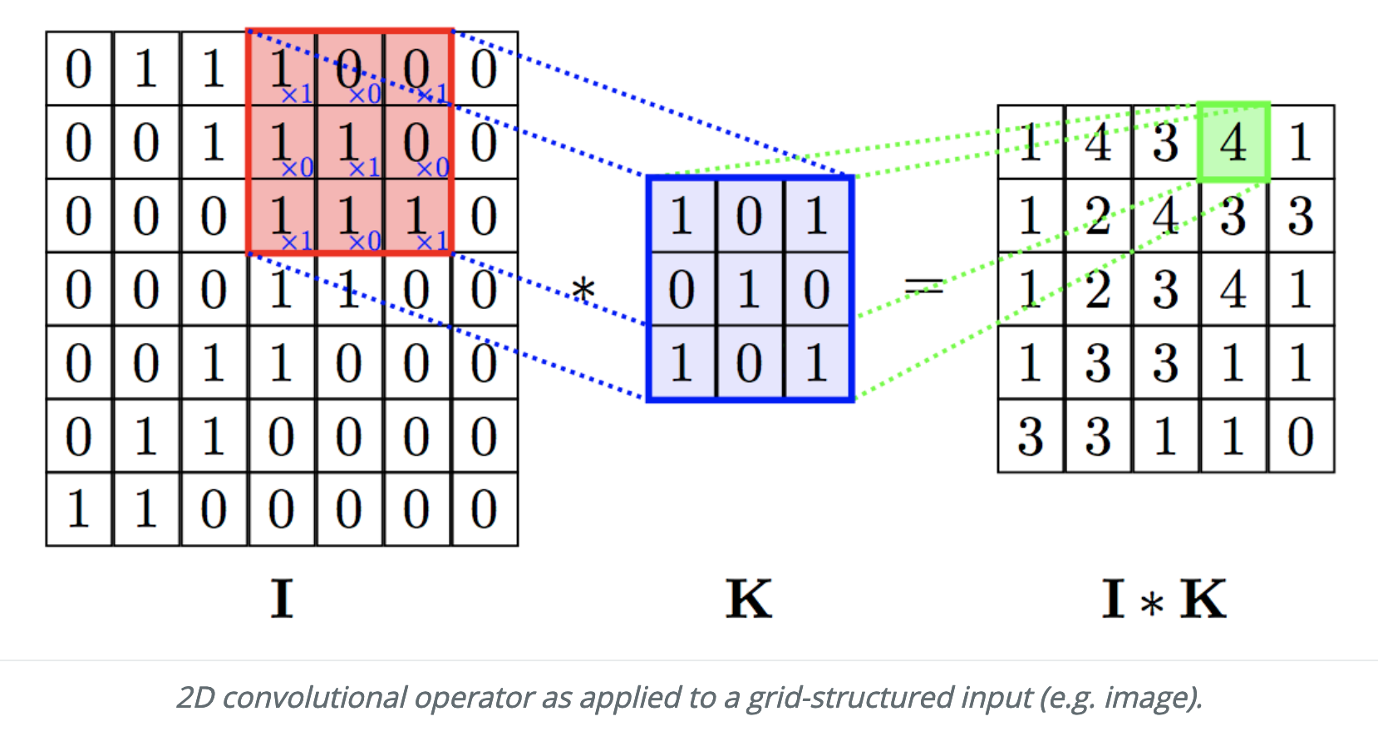
Motivation
CNN nicely exploits the Grid Structure
Images borrowed from Graph attention networks
Zhiyao Yan, Sainan Liu, Gautam Nain Lecture -
13

Slide 6
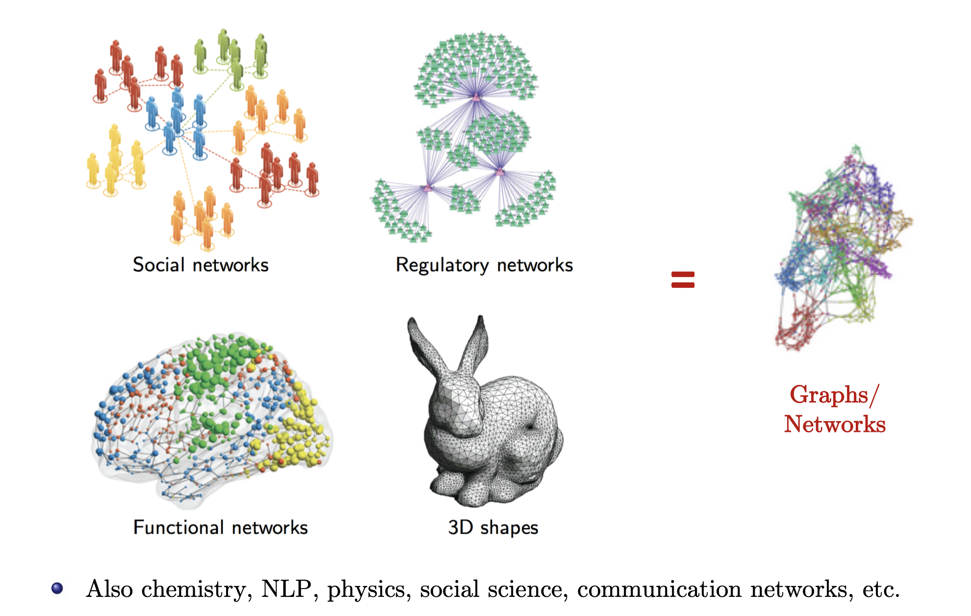
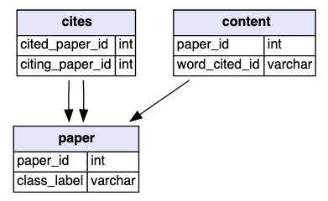
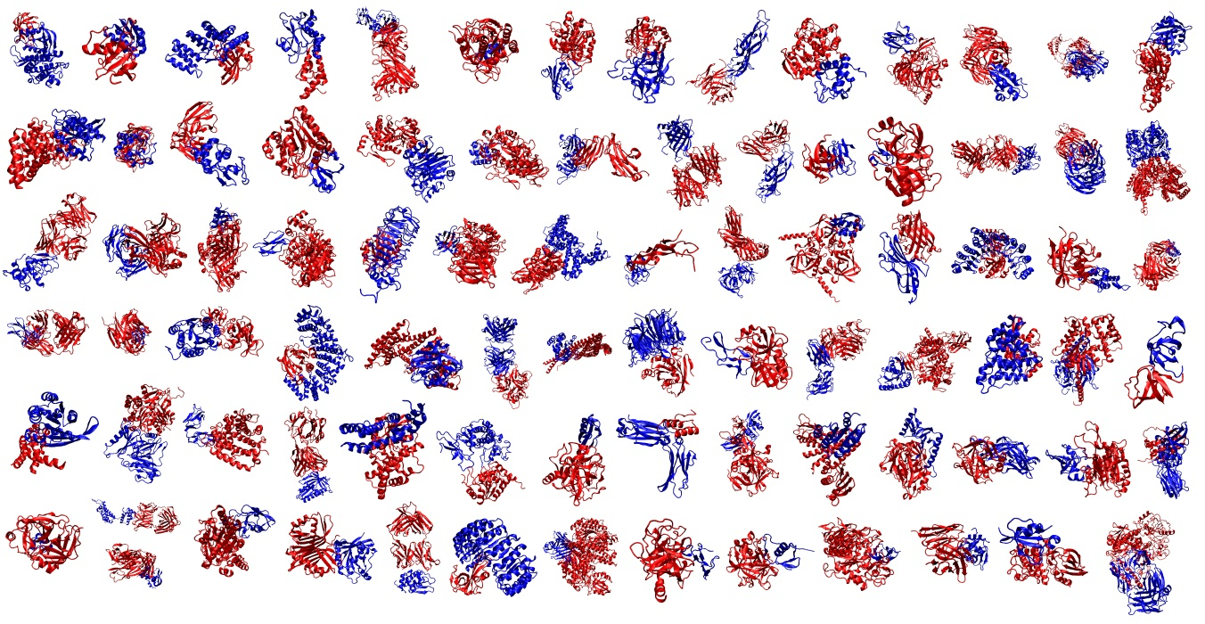
Motivation
What about data with arbitrary structures like Graphs?
CORA
PPI Affinity 2.0
Also chemistry, physics, communication networks, social science etc.
Image borrowed from Bresson’s
Zhiyao Yan, Sainan Liu, Gautam Nain Lecture -
13

Slide 7
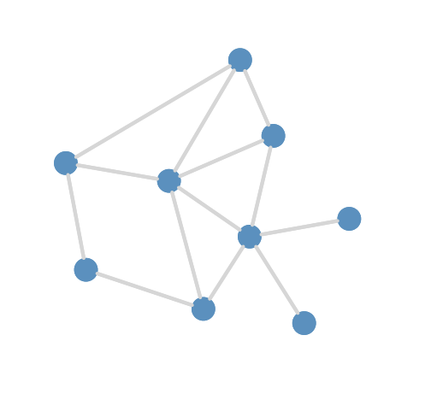
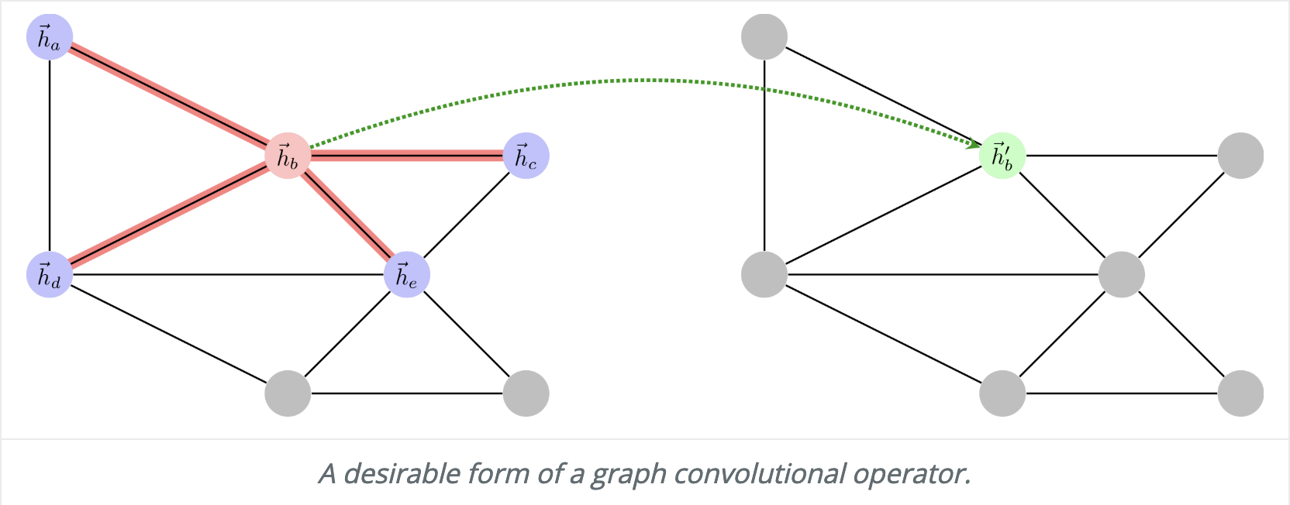
Motivation
What if the data looks like this →
We can Still Perform Convolution as below
Image Borrowed from Graph attention networks
Zhiyao Yan, Sainan Liu, Gautam Nain Lecture -
13

Slide 8
Outline
Motivation
Background:
Graph Definition
Spatial vs Spectral Domains
Challenges
Paper:
DCNN
GATs
SyncSpecCNN
Summary
Takeaway & References
Zhiyao Yan, Sainan Liu, Gautam Nain Lecture -
13

Slide 9
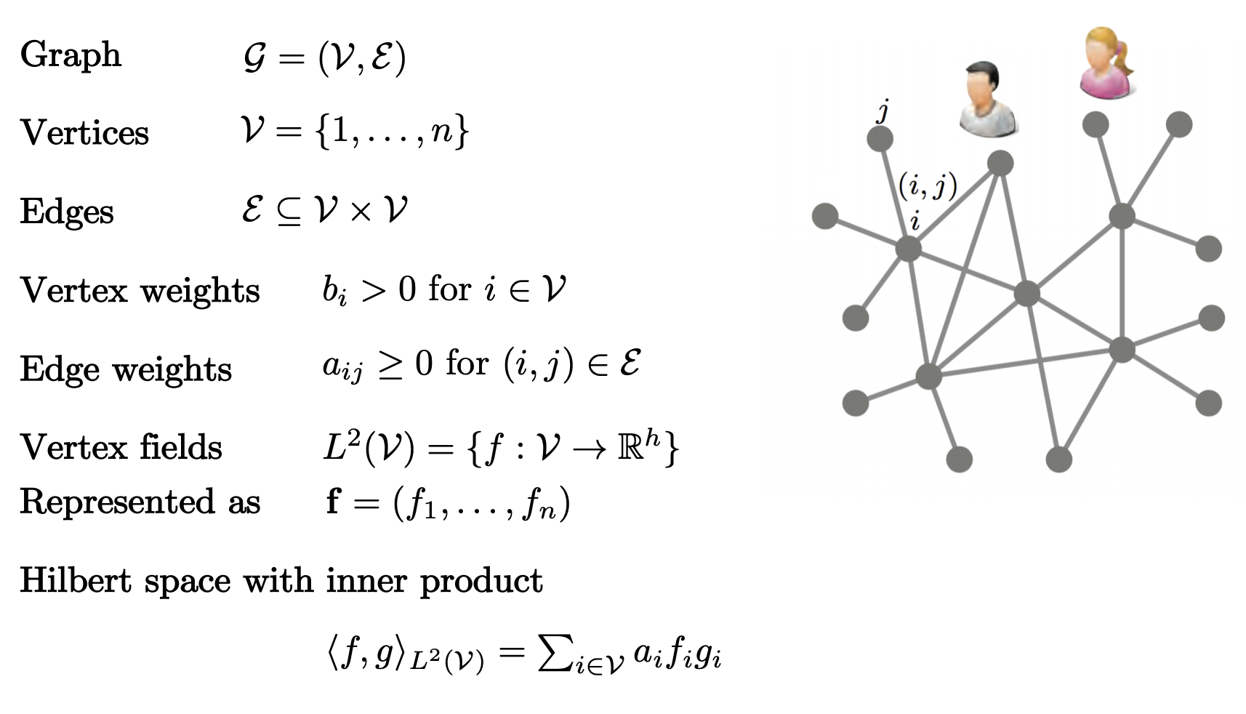
Graph Definition
Borrowed from Yi Li
Zhiyao Yan, Sainan Liu, Gautam Nain Lecture -
13

Slide 10
Outline
Motivation
Background:
Graph Definition
Spatial vs Spectral Domains
Challenges
Paper:
DCNN
GATs
SyncSpecCNN
Summary
Takeaway & References
Zhiyao Yan, Sainan Liu, Gautam Nain Lecture -
13

Slide 11
Spatial vs Spectral
Two major approaches to build Graph CNNs
Spatial Domain:
Perform convolution in spatial domain similar to images (euclidean data) with shareable weight parameters
Spectral Domain:
Convert Graph data to spectral domain data by using the eigenvectors of laplacian operator on the graph data and perform learning on the transformed data.
Zhiyao Yan, Sainan Liu, Gautam Nain Lecture -
13

Slide 12
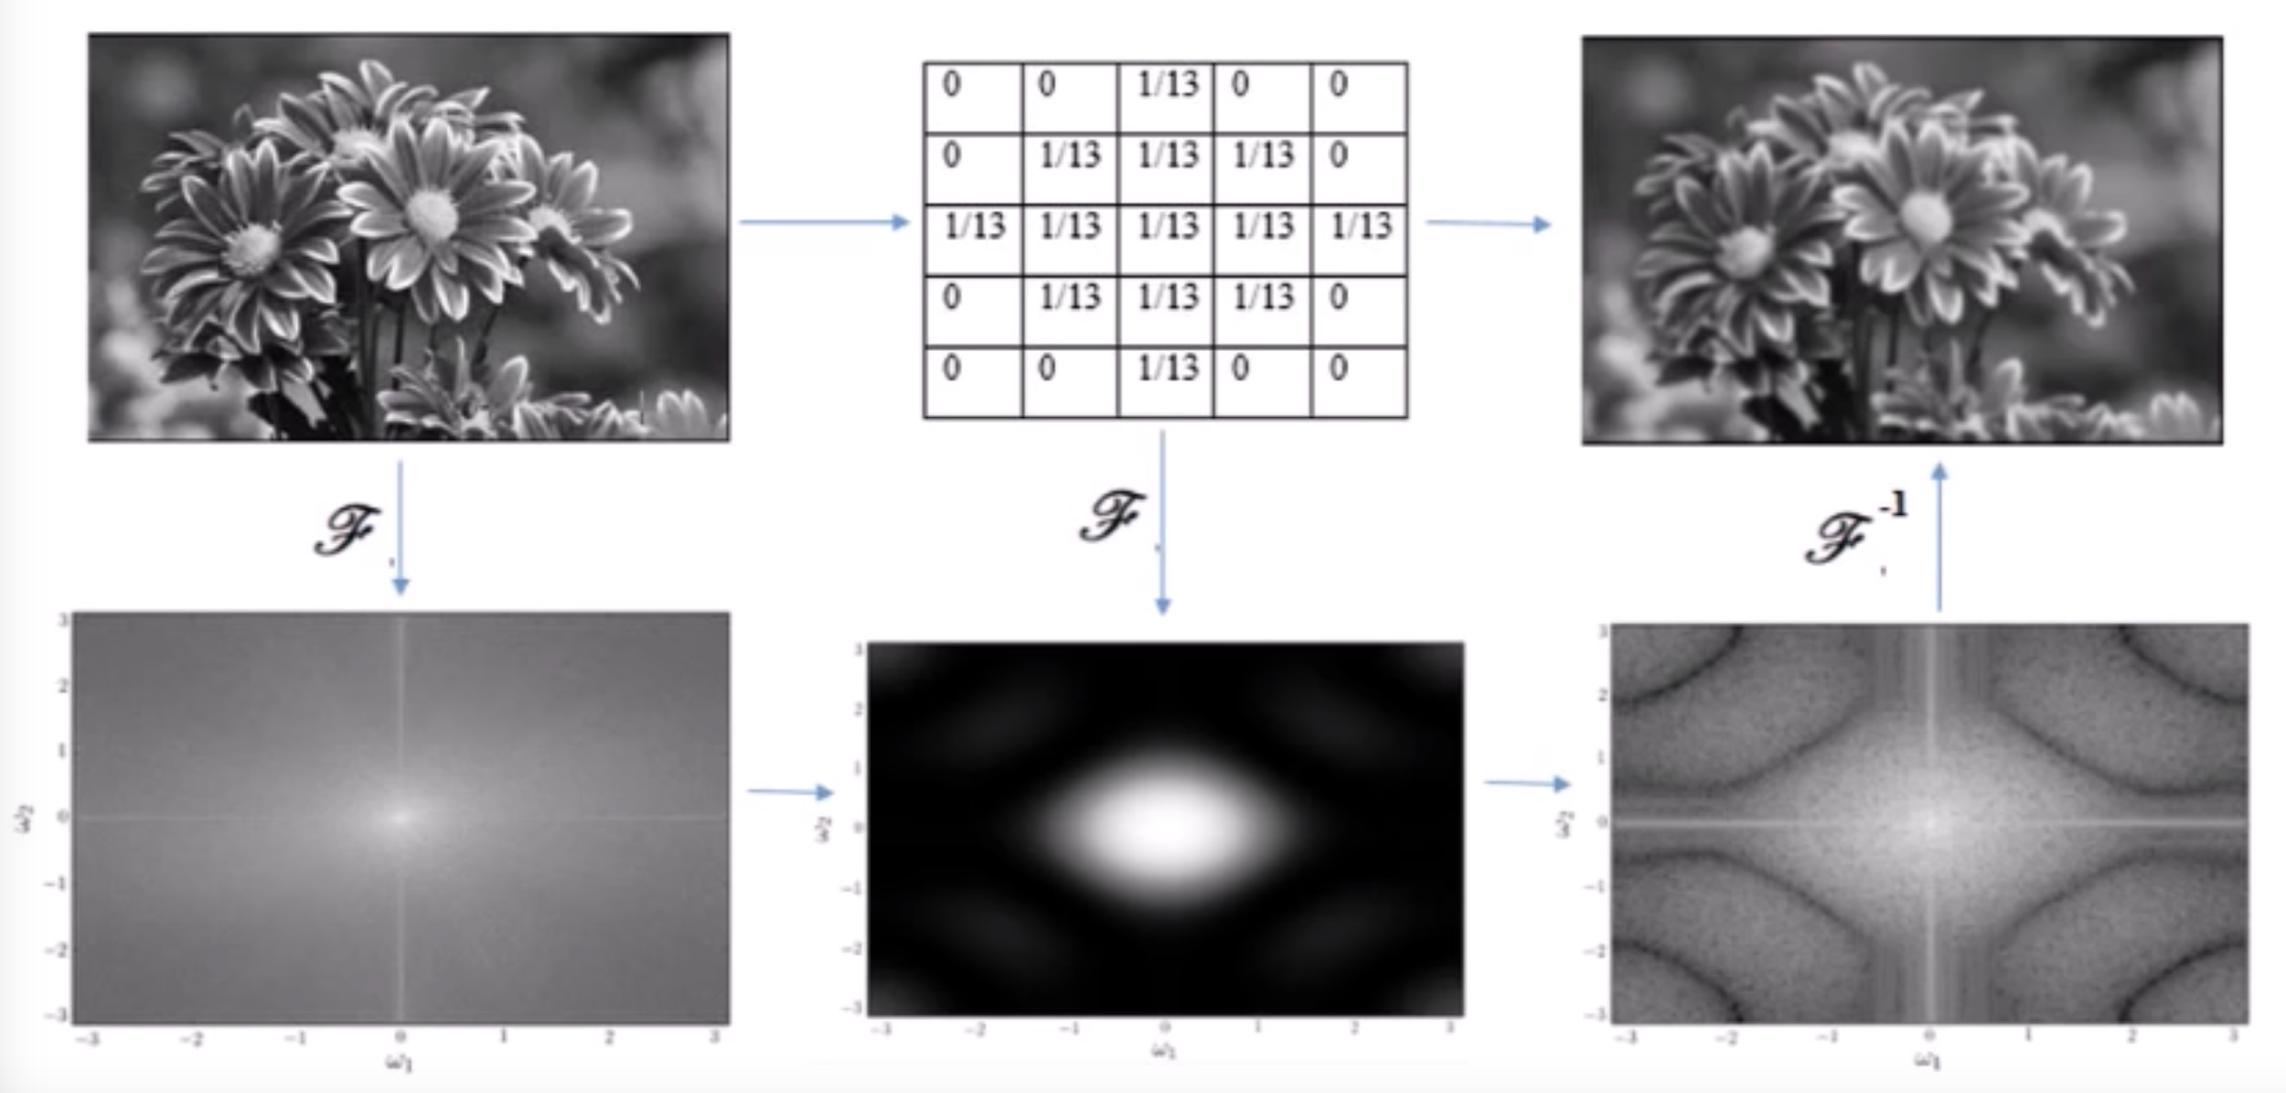
Spatial vs Spectral - 2D Image
Convolution comparison:
Borrowed from Sidd Signal
Zhiyao Yan, Sainan Liu, Gautam Nain Lecture -
13
Notes:
https://youtu.be/FRZvgNvALJ4?t=392 ← this series seems very intuitive. Maybe we can borrow the slides
http://math.uchicago.edu/~may/REU2012/REUPapers/JiangJ.pdf
https://www.youtube.com/watch?v=xhO8iz2qCOE has a really good explanation about why these 2D fourier transform images look like this.

Slide 13
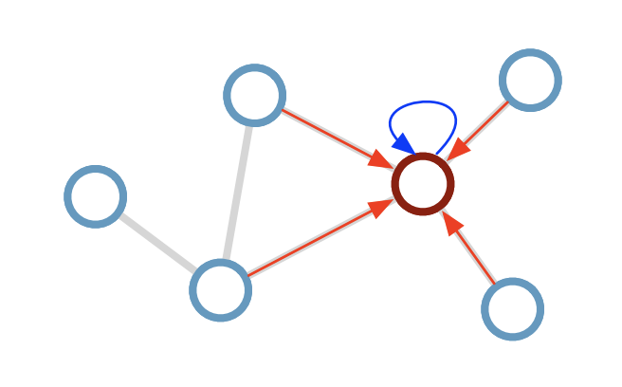
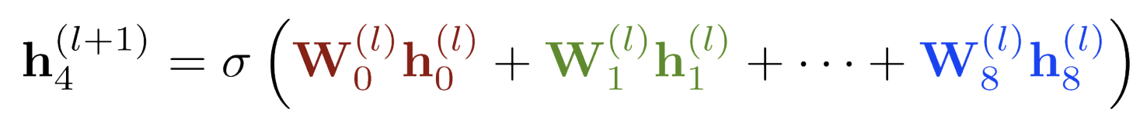
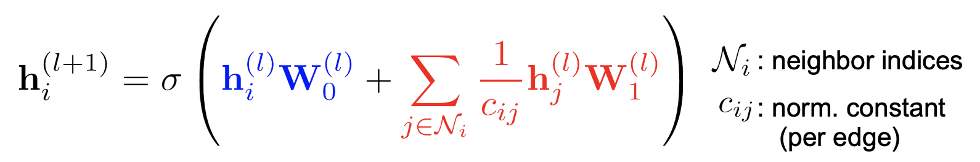
Spatial Domain
Standard CNN on Images:
CNN on Graphs:
Update Rule:
Update Rule:
Images borrowed from Kipf
Zhiyao Yan, Sainan Liu, Gautam Nain Lecture -
13

Slide 14
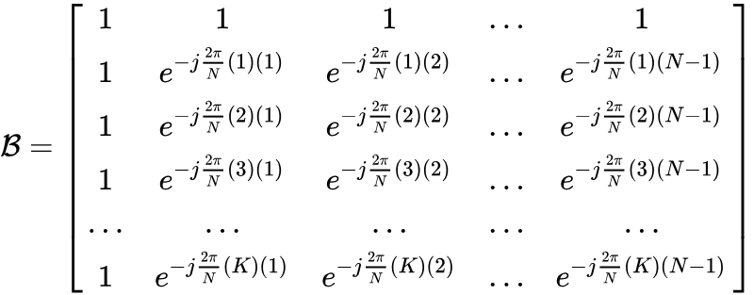

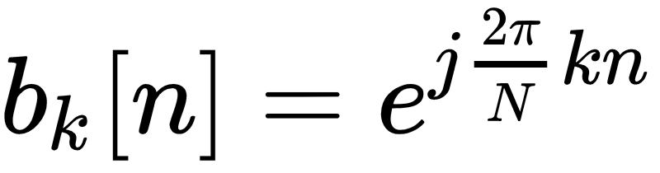
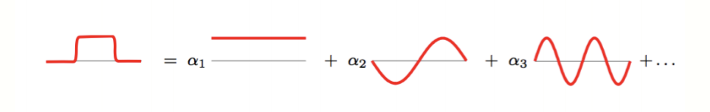
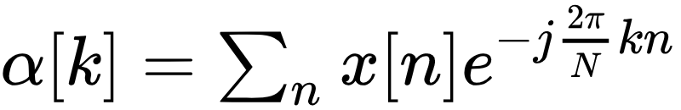
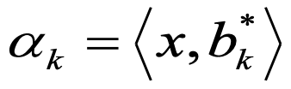
Spectral Domain -1D Case
Frequency Space
We can use the Fourier basis to transform the image to frequency space.
The Frequency space data provides us with a different representation of our Image data
This new representation can be used to learn different sets of features for the image data.
Row vectors of forms the fourier basis
Zhiyao Yan, Sainan Liu, Gautam Nain Lecture -
13
Notes:
Sin wave reference : https://www.youtube.com/watch?v=xhO8iz2qCOE
Convolution reference:
https://www.youtube.com/watch?v=oACegp4iGi0

Slide 15

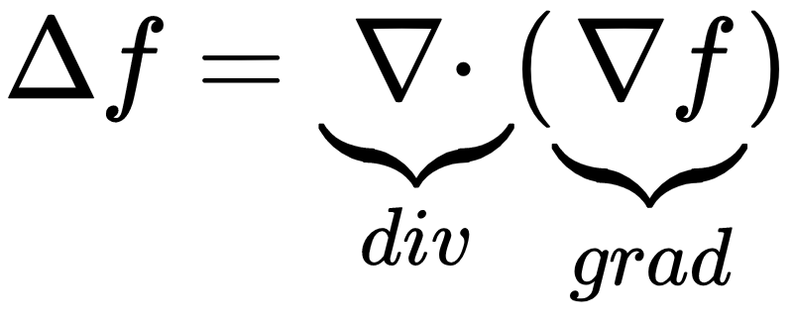

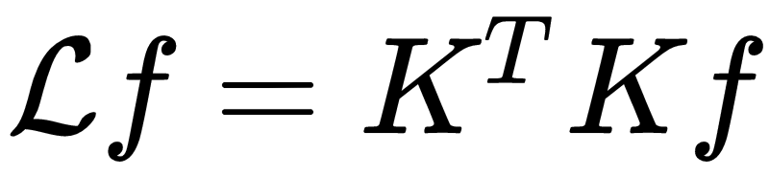


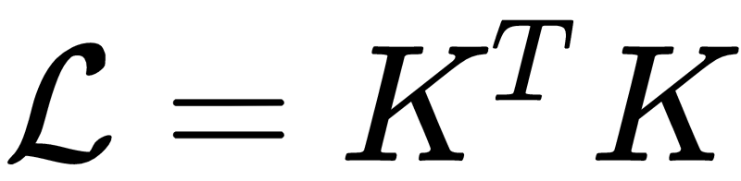
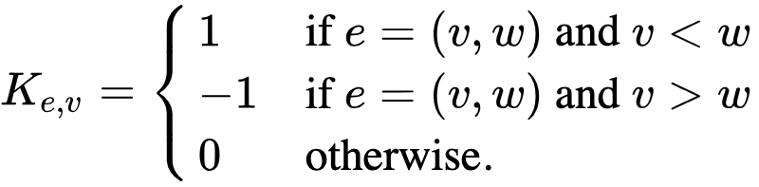
Spectral Graph Theory
Discrete Laplacian (Graphs)
Gradient in graphs is calculated by computing the differences (derivative for the discrete case) along the edges
The divergence operator for graphs can directly be given by the incidence matrix
Laplacian of is given by:
Where is the laplacian operator
For Graphs the laplacian operator can be defined in terms of the incidence matrix as below:
Where is the incidence matrix and is the laplacian matrix. Therefore,
Incidence Matrix:
K is an mxn matrix where m is the number of edges and n is number of nodes/vertices
Zhiyao Yan, Sainan Liu, Gautam Nain Lecture -
13
Notes:
https://youtu.be/FRZvgNvALJ4?t=392 ← this series seems very intuitive. Maybe we can borrow the slides
http://math.uchicago.edu/~may/REU2012/REUPapers/JiangJ.pdf

Slide 16
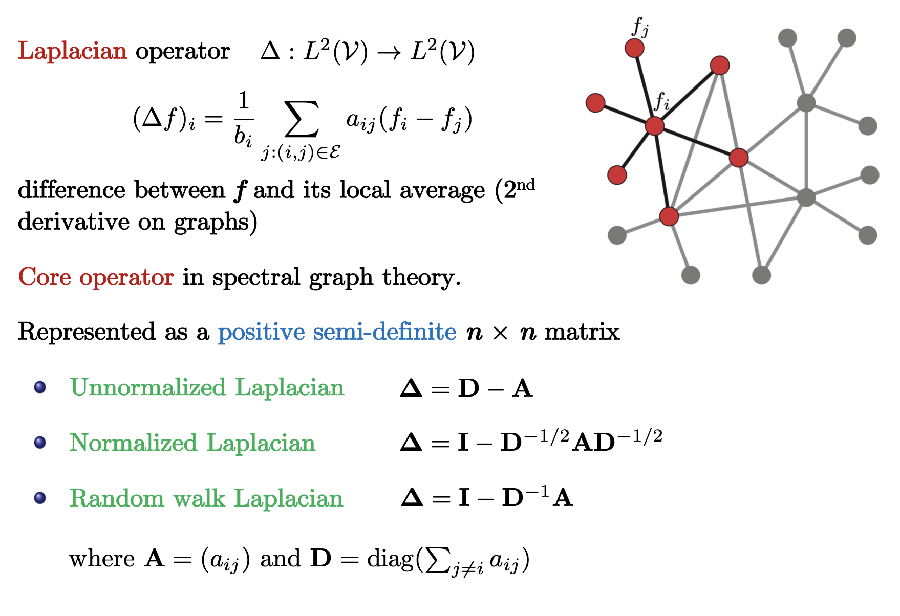
Spectral Graph Theory
Graph Laplacian
/2
Borrowed from Yi Li
Zhiyao Yan, Sainan Liu, Gautam Nain Lecture -
13

Slide 17
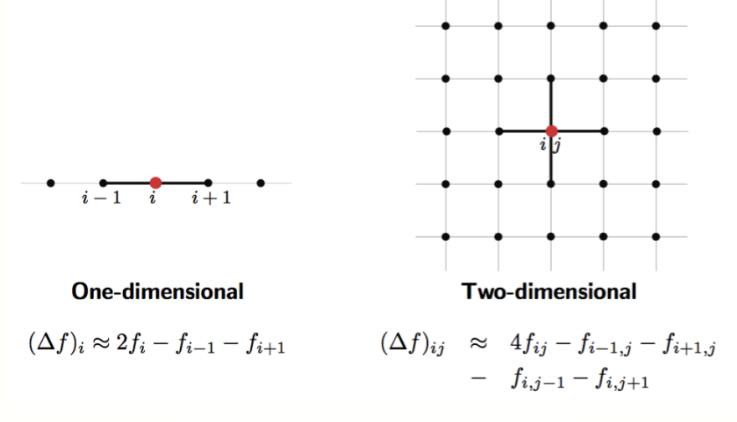
Spectral Graph Theory
Graph Laplacian - Example
Zhiyao Yan, Sainan Liu, Gautam Nain Lecture -
13
Notes:
https://youtu.be/FRZvgNvALJ4?t=392 ← this series seems very intuitive. Maybe we can borrow the slides
http://math.uchicago.edu/~may/REU2012/REUPapers/JiangJ.pdf

Slide 18
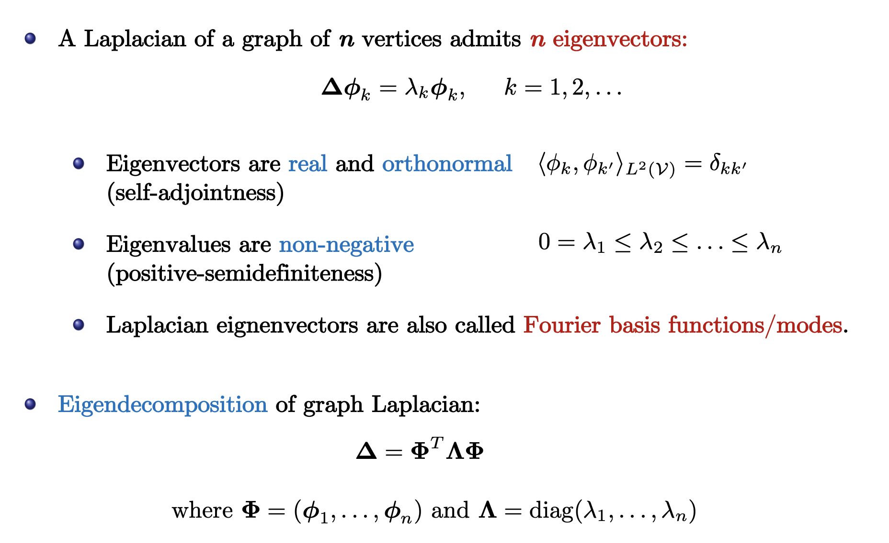
Spectral Graph Theory
Spectral Decomposition
The laplacian eigenbasis is a generalization of the classical fourier basis to non-Euclidean domains.
Borrowed from Kipf
Zhiyao Yan, Sainan Liu, Gautam Nain Lecture -
13

Slide 19
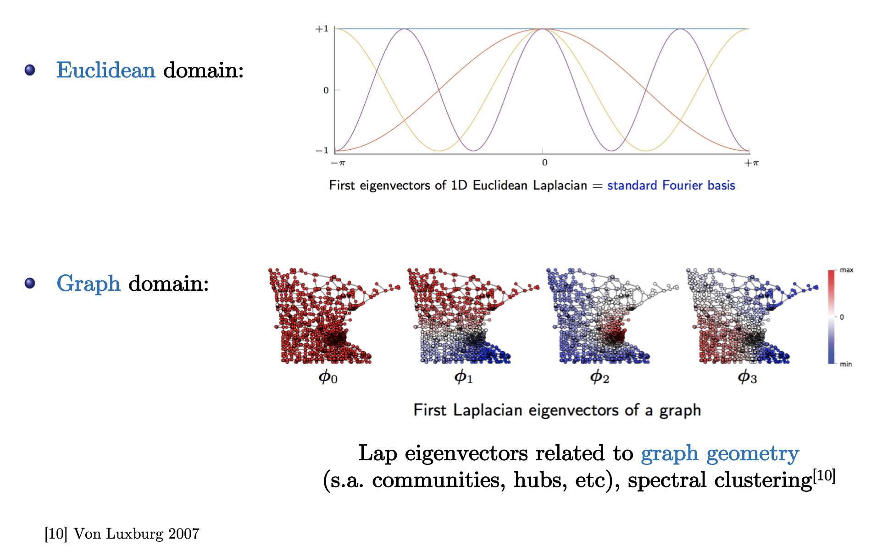
Spectral Graph Theory
Relation with Euclidean Spectral Analysis
Zhiyao Yan, Sainan Liu, Gautam Nain Lecture -
13

Slide 20
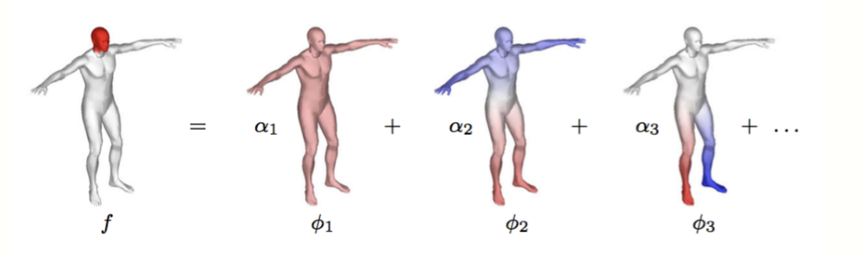
Spectral Graph Theory
Relation with Standard Spectral Analysis
Zhiyao Yan, Sainan Liu, Gautam Nain Lecture -
13
Notes:
https://youtu.be/FRZvgNvALJ4?t=392 ← this series seems very intuitive. Maybe we can borrow the slides
http://math.uchicago.edu/~may/REU2012/REUPapers/JiangJ.pdf

Slide 21
Spectral Graph Theory
Operate on “spectrum” of a matrix representing the graph (e.g. adjacency or Laplacian matrix)
L = D - A L - Laplacian matrix
D - Degree matrix
A - Adjacency matrix
Look at the eigenvectors and eigenvalues of the matrix
Zhiyao Yan, Sainan Liu, Gautam Nain Lecture -
13

Slide 22
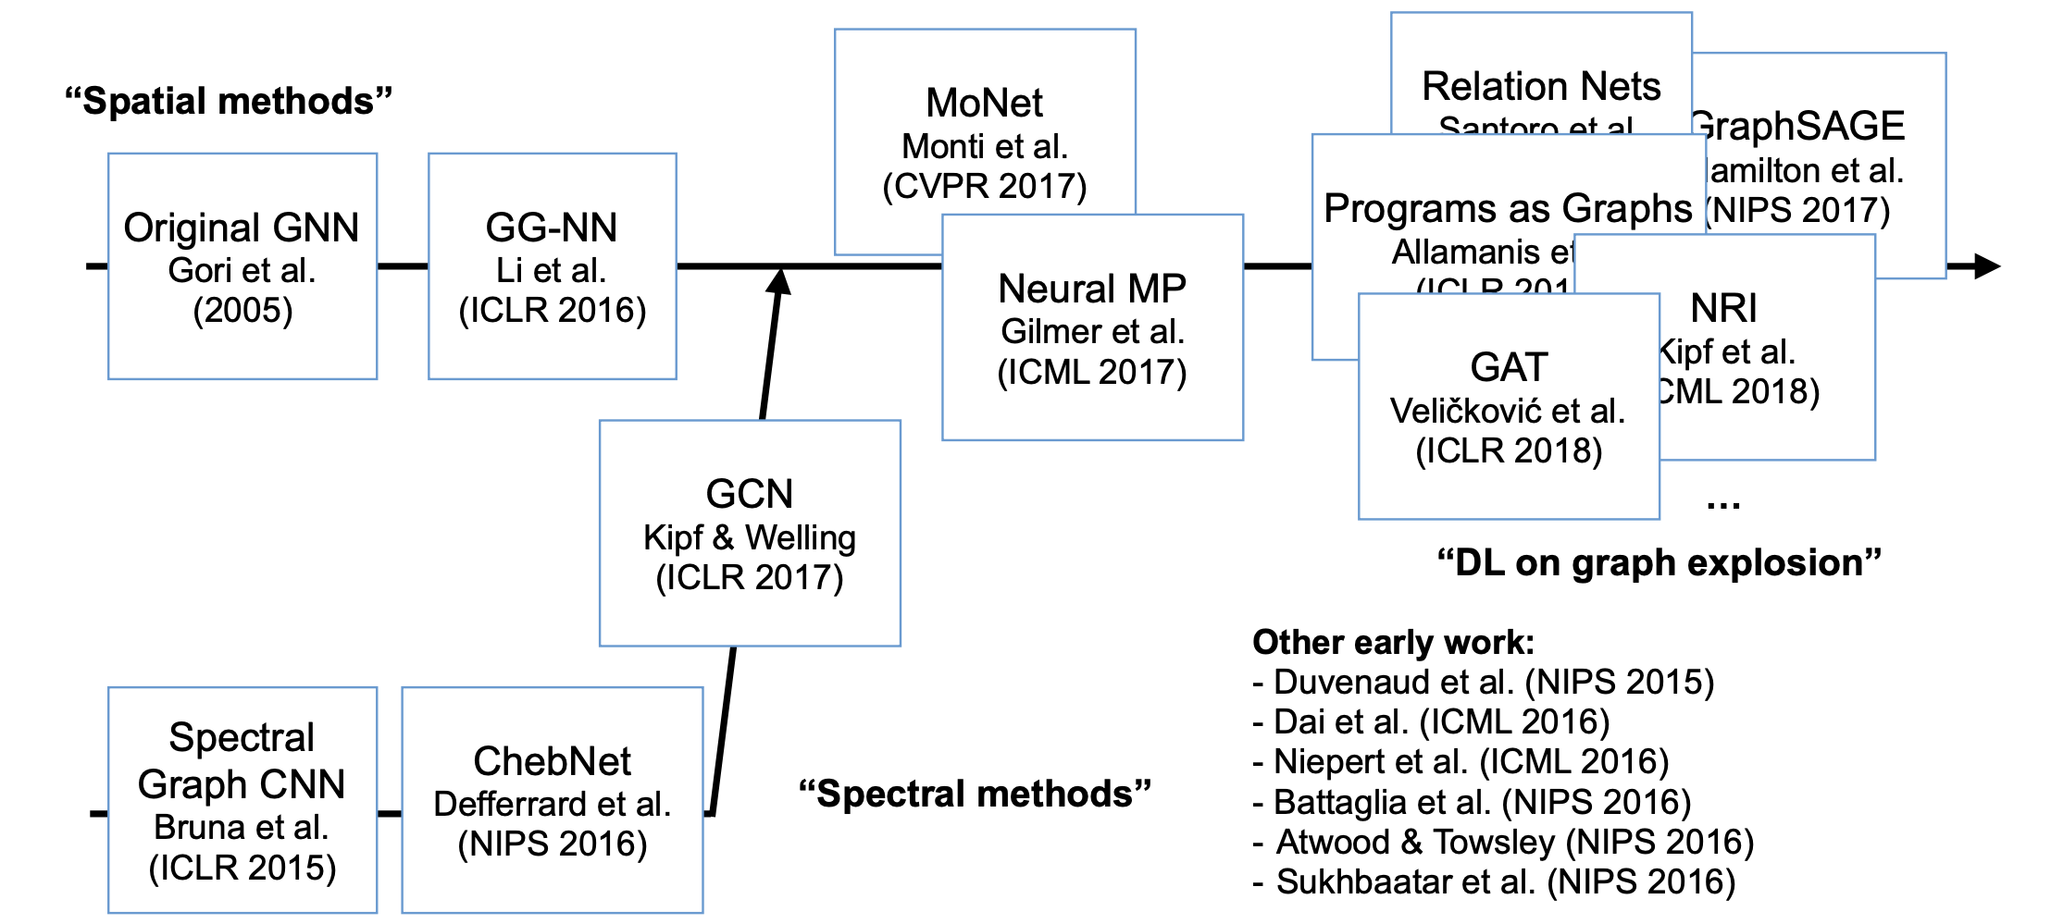
Spatial vs Spectral - A brief history
Image borrowed from Kipf
Zhiyao Yan, Sainan Liu, Gautam Nain Lecture -
13
Notes:
Explain that GCN is a combined method, everything is what they are on their level.

Slide 23
Outline
Motivation
Background:
Graph Definition
Spatial vs Spectral Domains
Challenges
Paper:
DCNN
GATs
SyncSpecCNN
Summary
Takeaway & References
Zhiyao Yan, Sainan Liu, Gautam Nain Lecture -
13

Slide 24
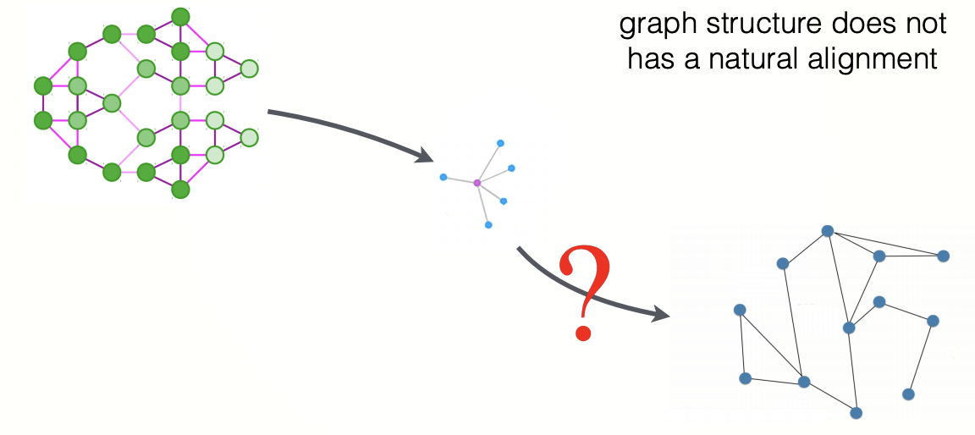
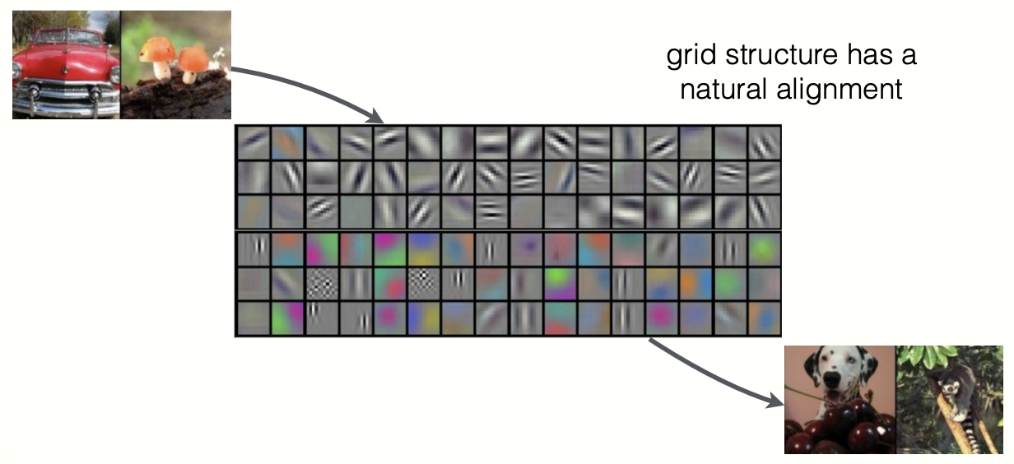
Challenges faced by Graph CNN:
How to define compositionality on graphs (i.e. convolution, downsampling, and pooling on graphs) ?
How to ensure generalizability across graphs?
And how to make them numerically fast? (as standard CNNs)
Zhiyao Yan, Sainan Liu, Gautam Nain Lecture -
13

Slide 25
Outline
Motivation
Background:
Graph Definition
Spatial vs Spectral Domains
Challenges
Paper:
DCNN
GATs
SyncSpecCNN
Summary
Takeaway & References
Zhiyao Yan, Sainan Liu, Gautam Nain Lecture -
13

Slide 26
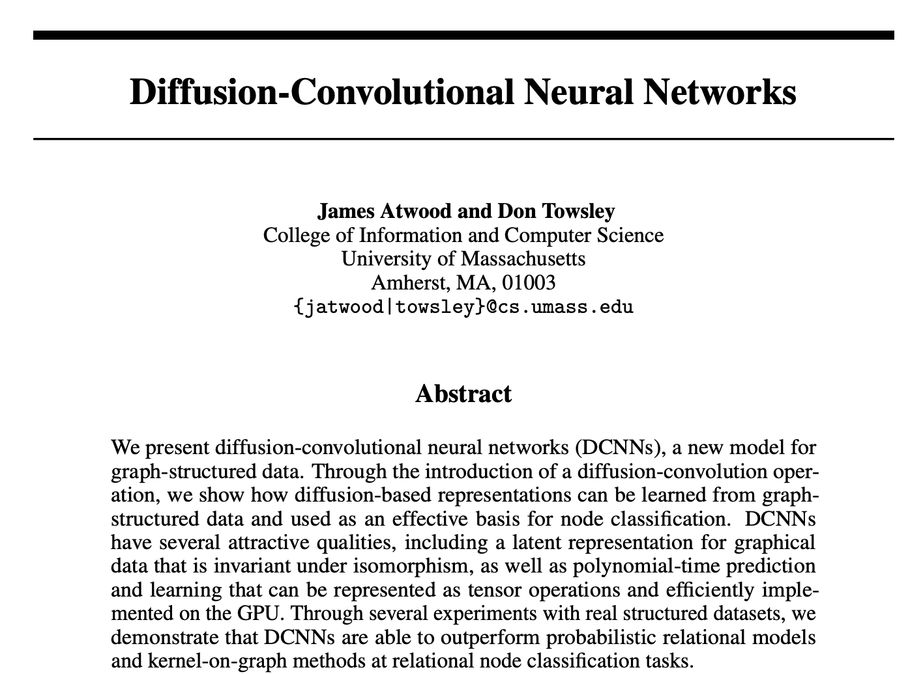
DCNN-Graph Diffusion
Zhiyao Yan, Sainan Liu, Gautam Nain Lecture -
13
Notes:
http://cseweb.ucsd.edu/~atsiatas/dissertation.pdf

Slide 27
DCNN-Graph Diffusion
Problems involving spreading/propagating along edges of a graph
Information about neighbors of nodes can help classification of nodes or an entire graph
Zhiyao Yan, Sainan Liu, Gautam Nain Lecture -
13
Notes:
http://cseweb.ucsd.edu/~atsiatas/dissertation.pdf

Slide 28
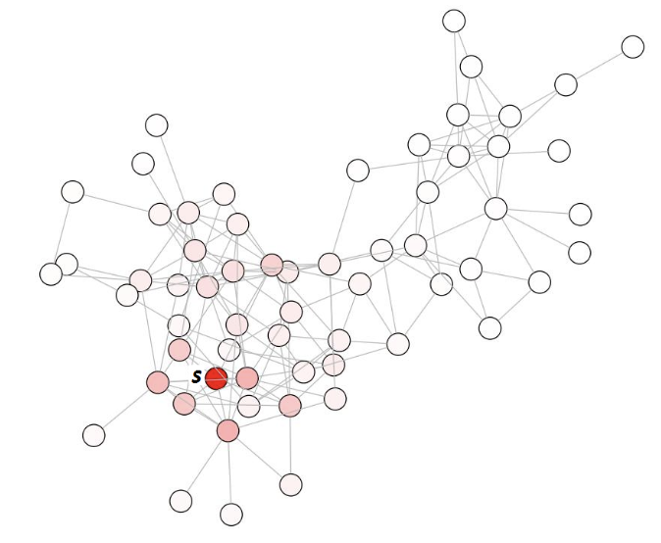
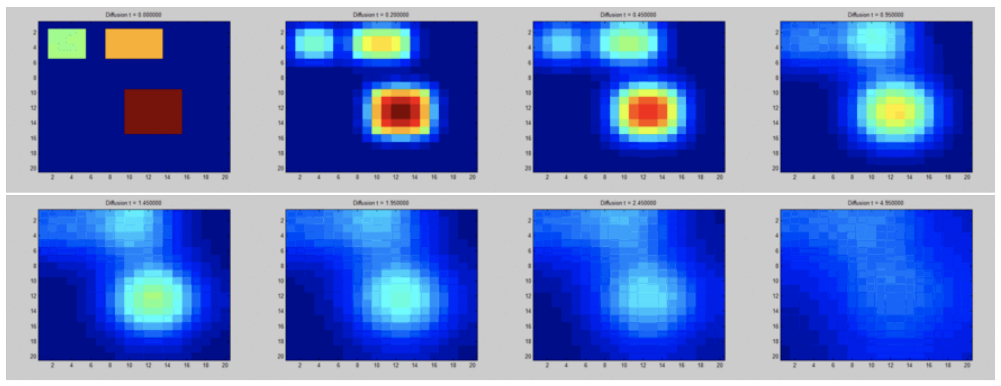
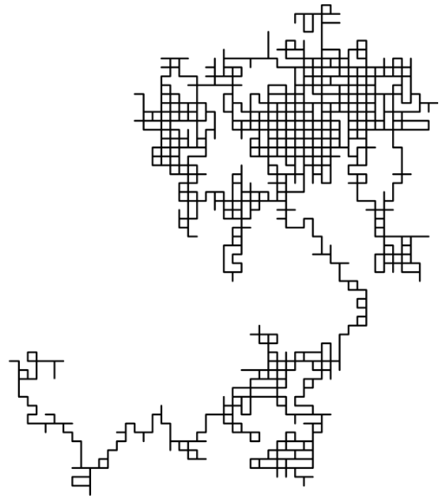
DCNN-Graph Diffusion
Random walk
PageRank
Heat diffusion
PageRank
Heat diffusion
Random walk
Zhiyao Yan, Sainan Liu, Gautam Nain Lecture -
13
Notes:
Graph diffusion seems to be a rather loosely defined term from what I can tell
http://www.leonidzhukov.net/hse/2015/networks/lectures/lecture11.pdf heat diffusion, random walk
http://cseweb.ucsd.edu/~atsiatas/dissertation.pdf pagerank

Slide 29
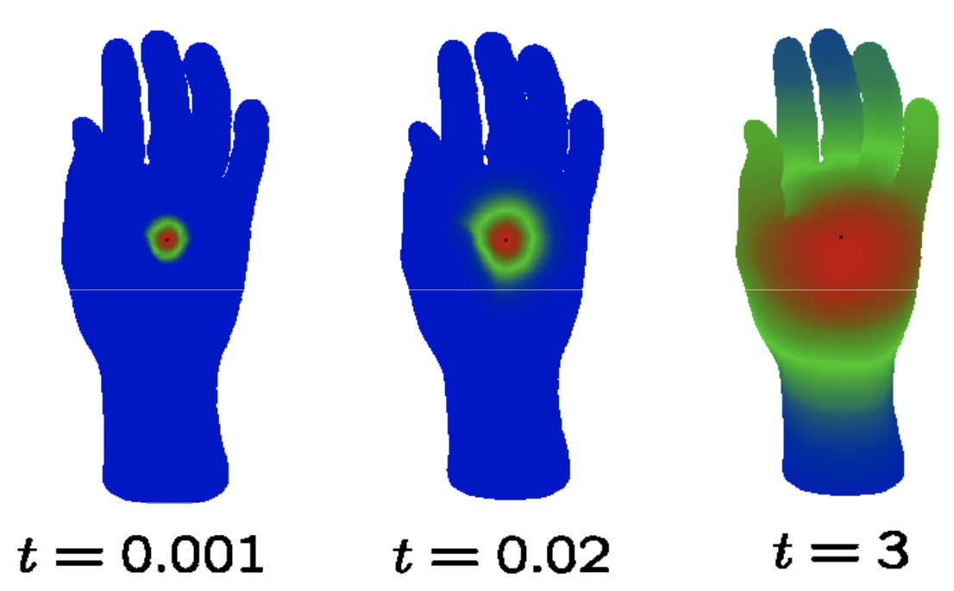
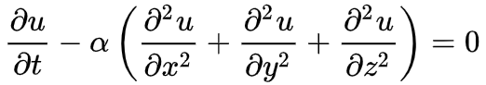
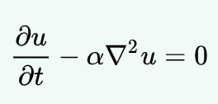
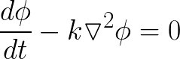
DCNN-Heat Diffusion
continuous
u - temperature
x,y,z - coordinates
t - time
α - thermal diffusivity
graph
ϕ - temperature
k - heat capacity
heat diffusion
Zhiyao Yan, Sainan Liu, Gautam Nain Lecture -
13

Slide 30
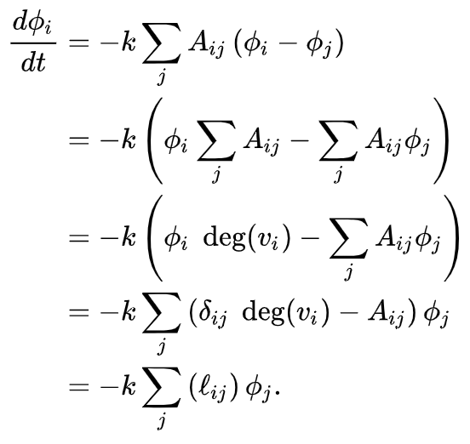
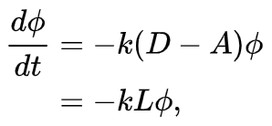
DCNN-Heat Diffusion on Graph
ϕ - temperature
k - heat capacity
heat diffusion
Zhiyao Yan, Sainan Liu, Gautam Nain Lecture -
13
Notes:
https://en.wikipedia.org/wiki/Laplacian_matrix

Slide 31
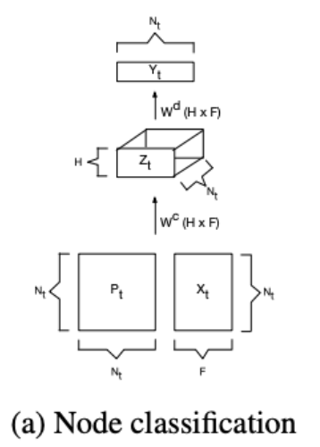
DCNN
Diffusion-Convolutional Neural Networks
Each node and edge in a graph is represented by some features X
Use the power series P of the transition matrix to model diffusion
Using the features X, power series P, and some learned weights W, we can propagate information through the graph
Zhiyao Yan, Sainan Liu, Gautam Nain Lecture -
13

Slide 32
DCNN
P: degree normalized transition matrix
P* = [P¹, P², …, P^{H-1}]
P = D⁻¹A
P¹ = [0.5 , 0.5 , 0. ],
[0.333 , 0.333 , 0.333 ],
[0. , 0.5 , 0.5 ]
P² = [0.417 , 0.417 , 0.167 ],
[0.278 , 0.444 , 0.278 ],
[0.167 , 0.417 , 0.417 ]
1
2
3
D - Degree matrix
A - Adjacency matrix
H - number of hops
Zhiyao Yan, Sainan Liu, Gautam Nain Lecture -
13
Notes:
Add what is A?
What is H?
P = D^(-1)A is the degree normalized A. AKA transition matrix
What is power series?

Slide 33
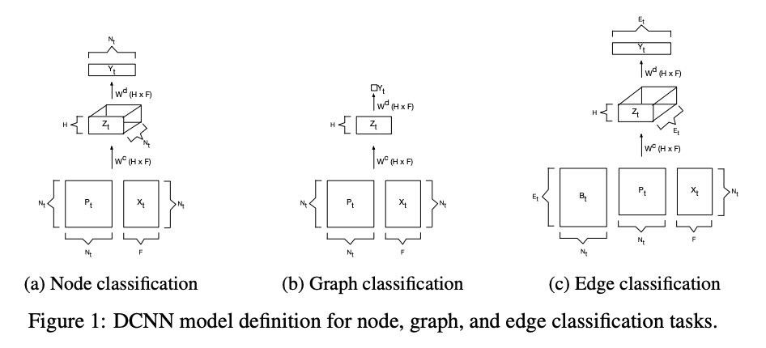
DCNN
Zhiyao Yan, Sainan Liu, Gautam Nain Lecture -
13
Notes:
Problem statement.
Draw the graph a on the board, no dimension or subscription of t needed.

Slide 34
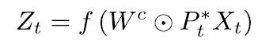
DCNN
N_{t} = number of nodes
H = number of hops
F = number of features
t = graph ID
Z_{t} : N_{t} × H × F activation
W_{t} : H × F learned weights
P*_{t} : N_{t} × H × N_{t} power series
X_{t} : N_{t} × F node features
f : nonlinear function
Zhiyao Yan, Sainan Liu, Gautam Nain Lecture -
13
Notes:
Relate element-wise multiplication to convolution
Mention shared weights

Slide 35
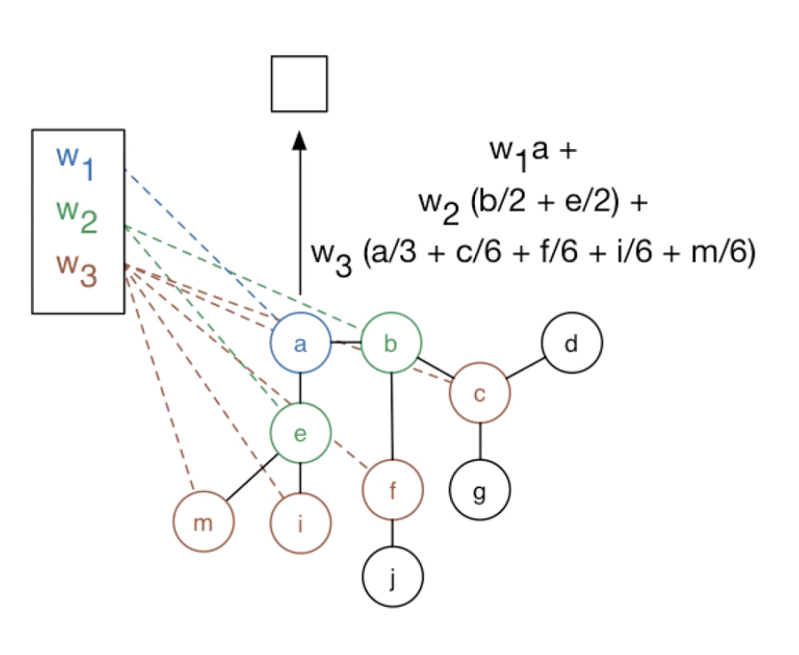
DCNN
P: degree normalized transition matrix
P* = [P¹, P², …, P^{H-1}]
Zhiyao Yan, Sainan Liu, Gautam Nain Lecture -
13

Slide 36
DCNN
High performance
Slow
Polynomial growth
O(N_{t}²F)
High memory usage
O(N_{t}²H)
Works up to hundreds of thousands of nodes
Zhiyao Yan, Sainan Liu, Gautam Nain Lecture -
13

Slide 37
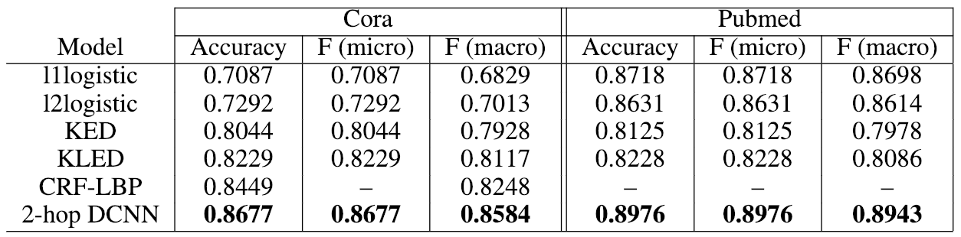
DCNN
CORA
PPI Affinity 2.0
Zhiyao Yan, Sainan Liu, Gautam Nain Lecture -
13

Slide 38
Outline
Motivation
Background:
Graph Definition
Spatial vs Spectral Domains
Challenges
Paper:
DCNN
GATs
SyncSpecCNN
Summary
Takeaway & References
Zhiyao Yan, Sainan Liu, Gautam Nain Lecture -
13

Slide 39
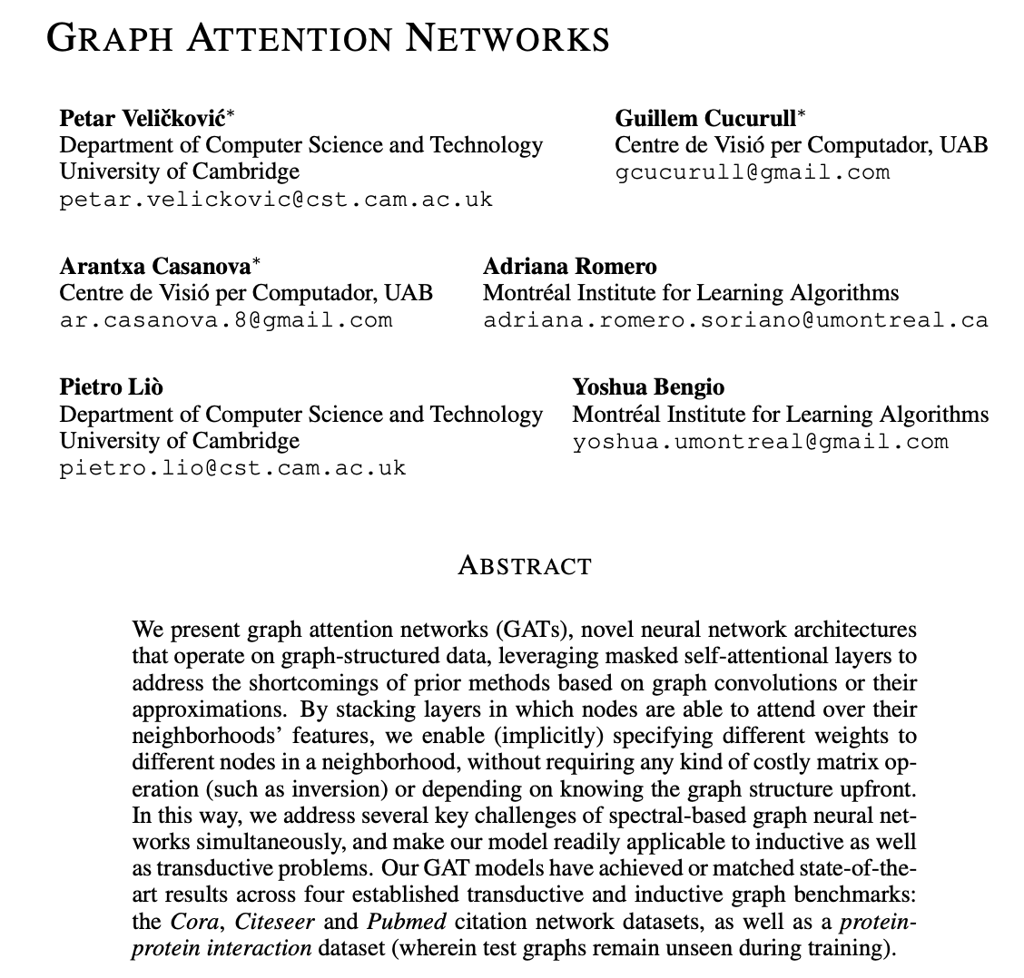
Graph Attention Networks (GAT)
Zhiyao Yan, Sainan Liu, Gautam Nain Lecture -
13

Slide 40
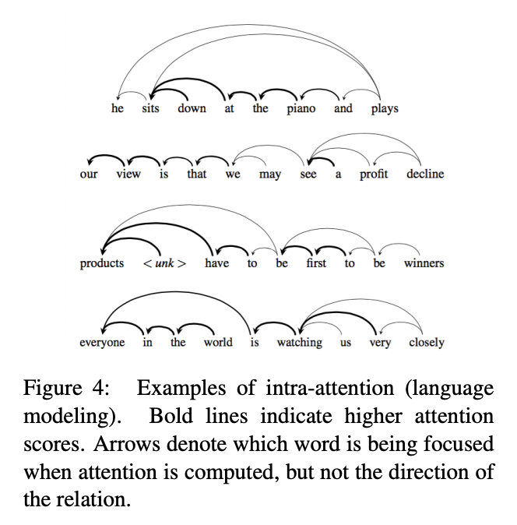
Graph Attention Networks (GAT)
Motivation:
Self attention provides powerful models for machine translation task
Attention networks has less computational complexity
Attention networks can be parallelized for faster computations.
Machine translation task are similar to Graphical data
This paper utilizes attention networks for graph structured data.
Zhiyao Yan, Sainan Liu, Gautam Nain Lecture -
13

Slide 41
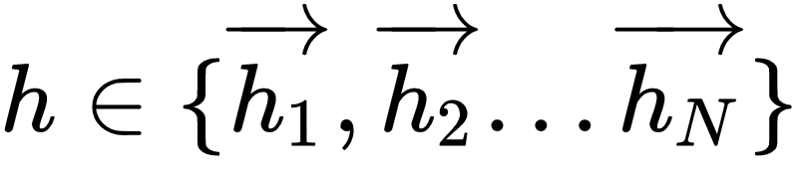
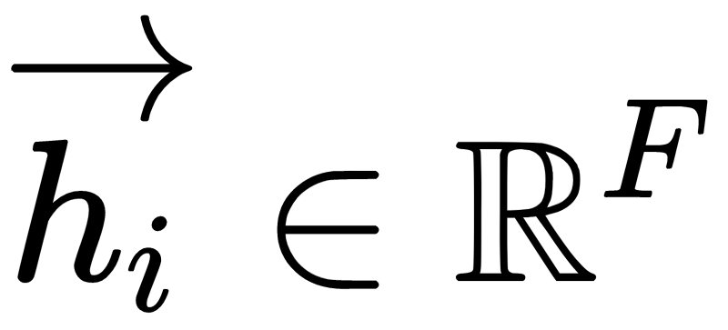

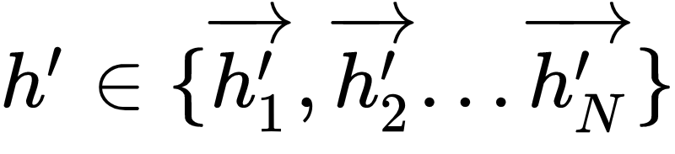



GAT ARCHITECTURE
Input to the Attention Network is a set of node features where and is the number of features each node.
A single Graph Attentional Layer produces a new set of node features where and is potentially new cardinality for each node.
A shared linear transformation, parameterized by the weight matrix is applied to every node.
Then a self attention mechanism is performed on these transformed features.
Zhiyao Yan, Sainan Liu, Gautam Nain Lecture -
13

Slide 42





GAT ARCHITECTURE
Attention Mechanism
a single layer feed- forward network
Parameterized by a weight vector
Masked attention is performed by computing for nodes some neighborhood of node i
Zhiyao Yan, Sainan Liu, Gautam Nain Lecture -
13

Slide 43



GAT ARCHITECTURE
Multi-head Attention
Brings stability to the learning process
Parallelly executes K attention mechanisms
An illustration of multi-head attention with K=3 heads by node 1 on its neighbourhoods
Zhiyao Yan, Sainan Liu, Gautam Nain Lecture -
13

Slide 44
Properties of GAT
Computational and Storage Efficiency
Fixed number of parameters (independent of input graph size)
Localisation - acting on a local neighbourhood of a node
Ability to specify arbitrary importances to different neighbours
Applicability to inductive problems
Zhiyao Yan, Sainan Liu, Gautam Nain Lecture -
13

Slide 45


GAT Applications
Mesh Based Parcellation of the cerebral cortex
Neural Paratope Prediction
Zhiyao Yan, Sainan Liu, Gautam Nain Lecture -
13

Slide 46
Outline
Motivation
Background:
Graph Definition
Spatial vs Spectral Domains
Challenges
Paper:
DCNN
GATs
SyncSpecCNN
Summary
Takeaway & References
Zhiyao Yan, Sainan Liu, Gautam Nain Lecture -
13

Slide 47

SyncSpecCNN
Yi, L., Su, H., Guo, X., Guibas, L. (2017)
Zhiyao Yan, Sainan Liu, Gautam Nain Lecture -
13

Slide 48

SyncSpecCNN
Problem:
Input:
Shape Graph (L)
Vertex Functions
Output:
Vertex Label
Yi, L., Su, H., Guo, X., Guibas, L. (2017)
Zhiyao Yan, Sainan Liu, Gautam Nain Lecture -
13
Notes:
Vertex Functions (location, curvature, local context properties)

Slide 49

SyncSpecCNN
Challenges:
Yi, L., Su, H., Guo, X., Guibas, L. (2017)
Zhiyao Yan, Sainan Liu, Gautam Nain Lecture -
13

Slide 50
SyncSpecCNN
Solutions:
Lack of translation structure ⇨ Spatial convolution = point-wise multiplication in spectral domain.
Hard to do effective multi-scale analysis ⇨ Spectral dilated convolution
Non-isometric shapes does not generalize well ⇨ Functional map for synchronization
Zhiyao Yan, Sainan Liu, Gautam Nain Lecture -
13

Slide 51
SyncSpecCNN
Solutions:
Lack of translation structure ⇨ Spatial convolution = point-wise multiplication in spectral domain.
Hard to do effective multi-scale analysis ⇨ Spectral dilated convolution
Non-isometric shapes does not generalize well ⇨ Functional map for synchronization
Zhiyao Yan, Sainan Liu, Gautam Nain Lecture -
13

Slide 52

SyncSpecCNN
Yi, L., Su, H., Guo, X., Guibas, L. (2017)
Zhiyao Yan, Sainan Liu, Gautam Nain Lecture -
13

Slide 53
SyncSpecCNN
Solutions:
Lack of translation structure ⇨ Spatial convolution = point-wise multiplication in spectral domain.
Hard to do effective multi-scale analysis ⇨ Spectral dilated convolution
Non-isometric shapes does not generalize well ⇨ Functional map for synchronization
Zhiyao Yan, Sainan Liu, Gautam Nain Lecture -
13

Slide 54

SyncSpecCNN
Receptive Field Recap for Images
by Dang Ha The Hien
Zhiyao Yan, Sainan Liu, Gautam Nain Lecture -
13
Notes:
In grid images

Slide 55

SyncSpecCNN
Dilated Convolution in 2D
1-dilated
Receptive field = 3x3
2-dilated
Receptive field = 7x7
4-dilated
Receptive field = 15x15
Yu, Fisher & Koltun, V (2016)
Zhiyao Yan, Sainan Liu, Gautam Nain Lecture -
13
Notes:
In grid images

Slide 56

SyncSpecCNN
Spectral Dilated Convolution
Yi, L., Su, H., Guo, X., Guibas, L. (2017)
Zhiyao Yan, Sainan Liu, Gautam Nain Lecture -
13

Slide 57
SyncSpecCNN
Solutions:
Lack of translation structure ⇨ Spatial convolution = point-wise multiplication in spectral domain.
Hard to do effective multi-scale analysis ⇨ Spectral dilated convolution
Non-isometric shapes does not generalize well ⇨ Functional map for synchronization
Zhiyao Yan, Sainan Liu, Gautam Nain Lecture -
13

Slide 58

SyncSpecCNN
Cross Domain Consistency
Yi, L., Su, H., Guo, X., Guibas, L. (2017)
Zhiyao Yan, Sainan Liu, Gautam Nain Lecture -
13

Slide 59

SyncSpecCNN
Cross Domain Consistency
Yi, L., Su, H., Guo, X., Guibas, L. (2017)
Zhiyao Yan, Sainan Liu, Gautam Nain Lecture -
13

Slide 60

SyncSpecCNN
Different domains need to be synchronized.
Yi, L., Su, H., Guo, X., Guibas, L. (2017)
Zhiyao Yan, Sainan Liu, Gautam Nain Lecture -
13

Slide 61

SyncSpecCNN
Functional Map
SIGGRAPH2014 Course Notes
Zhiyao Yan, Sainan Liu, Gautam Nain Lecture -
13

Slide 62









SyncSpecCNN
Functional Map
Let
Original Mapping:
Functional representation of is:
While maybe a complicated mapping between surfaces, acts linearly between function spaces.
SIGGRAPH2014 Course Notes
Zhiyao Yan, Sainan Liu, Gautam Nain Lecture -
13
Notes:
C_ij is the jth coefficient of T_F(phi_i^M) in the basis phi_j^N.

Slide 63

SyncSpecCNN
Functional Map
SIGGRAPH2014 Course Notes
Zhiyao Yan, Sainan Liu, Gautam Nain Lecture -
13

Slide 64

SyncSpecCNN
Functional map for domain synchronization
Use linear maps to align individual graph bases with bases from a canonical domain, for better generalizability of spectral filters across domains.
Yi, L., Su, H., Guo, X., Guibas, L. (2017)
Zhiyao Yan, Sainan Liu, Gautam Nain Lecture -
13

Slide 65

SyncSpecCNN
Spectral Transformer Network
SpecTN is used to learn the linear map. SpecTN is trained together with the end task
Yi, L., Su, H., Guo, X., Guibas, L. (2017)
Zhiyao Yan, Sainan Liu, Gautam Nain Lecture -
13

Slide 66

SyncSpecCNN
Spectral Transformer Network
Generates high dimensional transformation, sensitive to initialization. (15 x 45 matrix)
Pre-trained to get a good starting point
Fine tuned with the end task learning
Yi, L., Su, H., Guo, X., Guibas, L. (2017)
Zhiyao Yan, Sainan Liu, Gautam Nain Lecture -
13
Notes:
Having large numbers, easily get stuck at a local minimum. Initialization can help reduce that.
15x45, maps the first 15 eigenbasis into a canonical domain of dimension 45 to allow very different shapes to be mapped into different subspaces.

Slide 67

SyncSpecCNN
Synchronization visualization
Yi, L., Su, H., Guo, X., Guibas, L. (2017)
Zhiyao Yan, Sainan Liu, Gautam Nain Lecture -
13

Slide 68

SyncSpecCNN
Network Architecture
Yi, L., Su, H., Guo, X., Guibas, L. (2017)
Zhiyao Yan, Sainan Liu, Gautam Nain Lecture -
13
Notes:
ReLU here adds the nonlinearity to the network as what people do in CNN
The dilation can be added to any of those SM modules to gain the same receptive field without going too deep. (Performance saturates after certain depth too?)
SpecTN is only added when the convolution kernels are not small, because small convolution kernels correspond to smoothly transiting multipliers in the spectral domain, therefore not very sensitive to bases misalignment among shapes graphs in a certain range of spectrum and are more generalizable across graphs.

Slide 69

SyncSpecCNN
Part segmentation and keypoint detection results.
Yi, L., Su, H., Guo, X., Guibas, L. (2017)
Zhiyao Yan, Sainan Liu, Gautam Nain Lecture -
13

Slide 70
Outline
Motivation
Background:
Graph Definition
Spatial vs Spectral Domains
Challenges
Paper:
DCNN
GATs
SyncSpecCNN
Summary
Takeaway & References
Zhiyao Yan, Sainan Liu, Gautam Nain Lecture -
13

Slide 71
Graph CNN Summary
Spatial construction is usually more efficient but less principled. (Diffusion and Attention papers)
Spectral construction is more principled but usually slow. Computing Laplacian eigenvectors for large scale data could be painful. (SyncSpecCNN)
Research tries to bridge the gap.(GCN by Kipf & Welling , Fast Localized Spectral Filtering by Defferrard et al)
Generalization issue on generic graphs is still a challenge.
Zhiyao Yan, Sainan Liu, Gautam Nain Lecture -
13

Slide 72
Graph CNN Summary
Review the challenges
How to define compositionality on graphs (i.e. convolution, downsampling, and pooling on graphs) ?
How to ensure generalizability across graphs?
And how to make them numerically fast? (as standard CNNs)
Zhiyao Yan, Sainan Liu, Gautam Nain Lecture -
13

Slide 73
Outline
Motivation
Background:
Graph Definition
Spatial vs Spectral Domains
Challenges
Paper:
DCNN
GATs
SyncSpecCNN
Summary
Takeaway & References
Zhiyao Yan, Sainan Liu, Gautam Nain Lecture -
13

Slide 74
Takeaways
What are graph networks?
What are the two domains the works are relying on?
What are their +’s and -’s?
What are the applications that can use graph networks?
Zhiyao Yan, Sainan Liu, Gautam Nain Lecture -
13

Slide 75
References
Atwood, J. and Towsley, D. Diffusion-Convolutional Neural Networks (2016)
Velickovic, P. et al. Graph Attention Networks (2018)
Boscaini, D. et al. Learning class-specific descriptors for deformable shapes using localized spectral convolutional networks (2015)
Yi, L., Su, H. , Guo, X. , Guibas, L. SyncSpecCNN: Synchronized Spectral CNN for 3D Shape Segmentation (2016)
Protein-Protein Interaction Affinity Database 2.0
Relational Dataset Repository - CORA
Defferrard, M. Bresson, X., Vandergheynst, P. Convolutional Neural Networks on Graphs with Fast Localized Spectral Filtering
Zhiyao Yan, Sainan Liu, Gautam Nain Lecture -
13

Slide 76

Scene Graphs
Visual Genome
2D natural images can be understood as a scene graph
Applications to scene understanding
Graph networks used in generation of scene graphs from natural images
Zhiyao Yan, Sainan Liu, Gautam Nain Lecture -
13

